Slide 1
SNOMED-CT codes for Prior-Authorization Prediction
Kolton Hauck
BMI6114
4/23/2024
Notes:
Hello, I am Kolton Hauck and my project revolves around using snomed codes for PA prediction
Now, there is a bit of a caveat to this, that I’ll get to

Slide 2








Background: Prior-Authorization (PA)
Notes:
Prior-authorization or PA, generally, is a process used by health insurers to pre-emptively ensure that a certain procedure, service, medication – whatever it may be – is a valid ‘thing’ to give to a patient based on the patient’s medical history, symptoms, health, and other factors
We have PA for a few reasons: notably to ensure the health and safety of the patient – by quickly authorizing procedures that they need and are medically necessary and appropriate for the condition
But PA also helps reduce unnecessary costs in healthcare
Ideally PA will improve patient outcomes by leading providers to the most effective treatments
should keep premiums more affordable
Automating this process would be beneficial for a few reasons
Manual PA is time consuming, labor-intensive
Delay could mean increased risk for the patient – waiting to be authorized
Can help reduce human error
Can help reduce administrative burden
Let me walk through a basic example
A patient gets sick and seeks care from their provider
Their provider identifies a need for a chest x-ray
Provider sends a PA request to the patient’s insurance company (along with other information such as the patient’s medical record)
The request gets review by the insurance company for medical necessity
Perhaps more information is requested
And then an approval or denial is issued

Slide 3
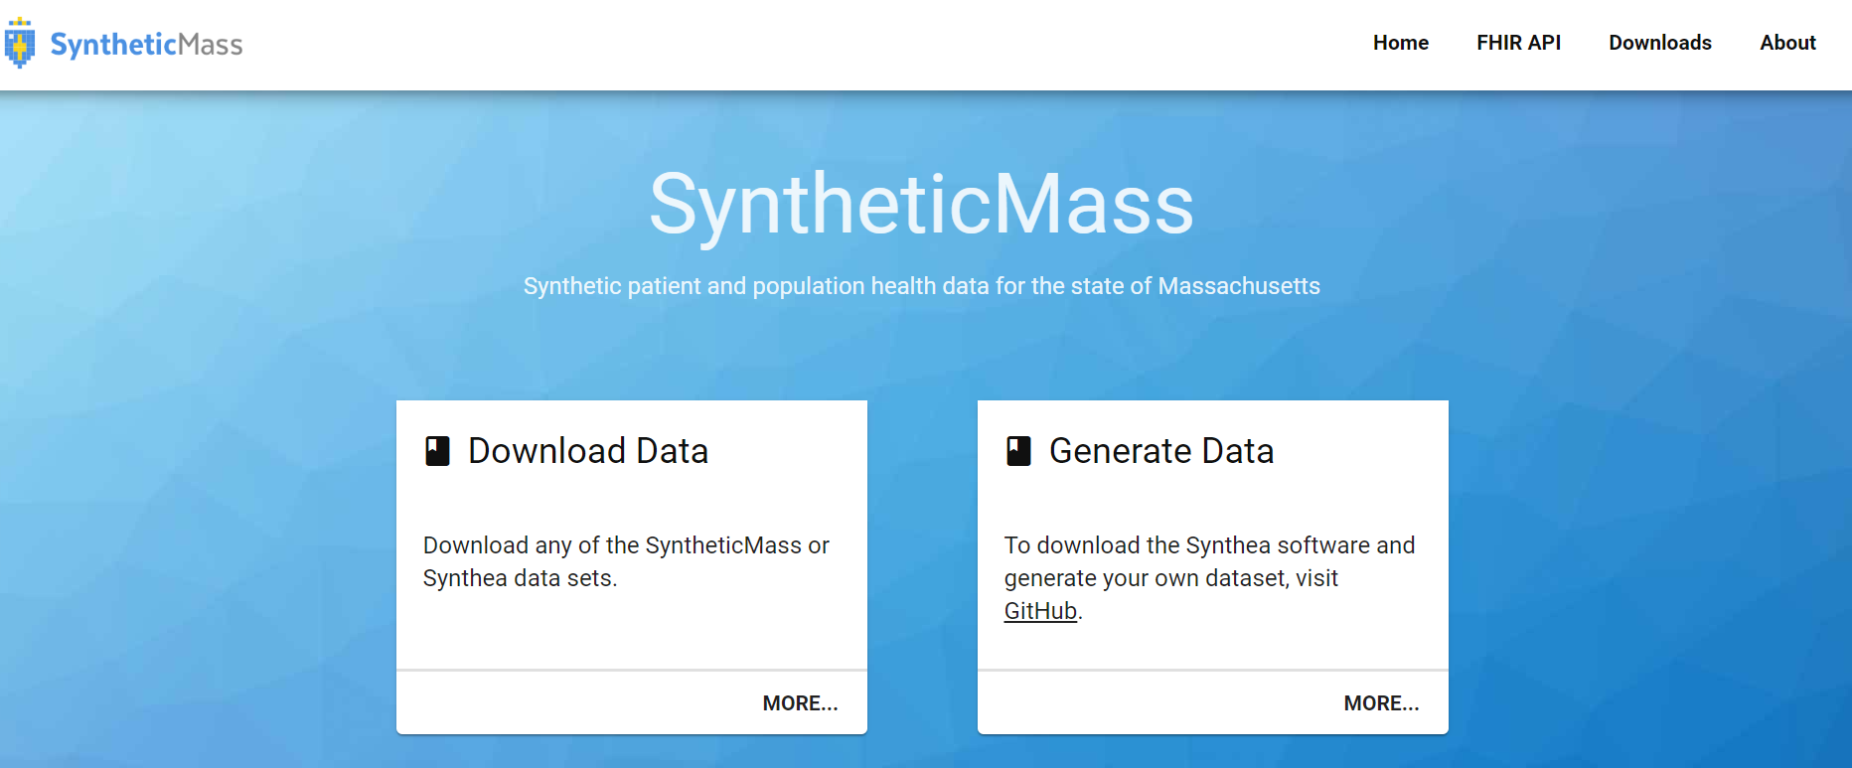
Synthea
https://synthea.mitre.org/
Notes:
To implement this, there are a few caveats I want to mention
I had trouble finding a dataset that has exactly what you would want for a PA-prediction task -> specifically the labels on whether a ‘something’ was authorized or not – if anyone knows of any good datasets out there, please let me know
Because of this went with synthea because you are able to generate a lot of samples – which I generated a little over 50,000 samples
Ways I simplified the project futher:
1) picked a single procedure of interest – ‘chest x-ray’ as these typically require PA and assumed that if a ‘chest x-ray’ was performed, then it was PA’d
2) The main problem though, is that there are no ‘negative’ observations – no declined Pas
so, I decided to keep ‘chest x-ray’ as my positive label and everything else as my negative label – this is not a PA prediction task anymore, but I figured that this would be a good starting point or proof of concept of the methodology used here. I figured that if the model could distinguish between if the next procedure is a Chest x-ray or something else, then it might translate ok to comparing if the next procedure is Chest x-ray or not.
Don’t know if that was a valid assumption or not, but I went with it

Slide 4

Project Setup - Data
Procedures
Chest X-ray
SNOMED-CT
Careplans
SNOMED-CT
Procedures
Chest X-ray
Conditions
SNOMED-CT
https://synthea.mitre.org/
Notes:
Synthea is essentially a relational database or a collection of tables with primary and foreign keys and other data
Each patient could have varying number of encounters.
Each encounter has a varying number of procedures associated with it, varying number of careplans and varying number of conditions (and more but I just included these)
Each of these procedures, careplans and conditions though are simply represent by a SNOMED-CT code – usually a Description code and a Reason Code.
Now to label my data, if there was a chest x-ray as a procedure, this patient became a positive observation, at which point, I disregarded this encounter completely (because I didn’t want that to influence the models) and kept the previous encounters as the features
Each previous encounter had their own associated procedures, careplans, conditions
Because there was a class imbalance, I oversampled this positive label by then taking the patients with multiple chest x-rays, and including the previous encounters to those procedures as another input feature
To demonstrate, this patient might have multiple chest x-rays. Not only do these 2 encounters become an observation because of this top chest x-ray, but I also take this encounter by itself as an observation because of this chest x-ray

Slide 5

Project Setup - Data
Procedures
SNOMED-CT
Careplans
SNOMED-CT
Conditions
SNOMED-CT
https://synthea.mitre.org/
Notes:
Now, as for a negative label, as long as they did not have any chest x-rays, they were a negative label

Slide 6
Project Setup - Preprocessing
SNOMED-CT
SNOMED-CT 1
vector 1
SNOMED-CT 2
vector 2
SNOMED-CT
SNOMED-CT 3
BioLORD-2023
vector 3
SNOMED-CT 4
vector 4
SNOMED-CT
SNOMED-CT N
vector N
*natural language SNOMED-CT descriptions
Notes:
So, I have my observations, I need my actual features now.
So, starting with my patient, who now has lots of collections of snomed codes, first I flattened these into a single vector
I ran these natural language descriptions through a sentence transformer – in this case BioLORD – which was actually trained on snomed codes and got out an array of embeddings
This array of embeddings is what was actually fed to the model

Slide 7
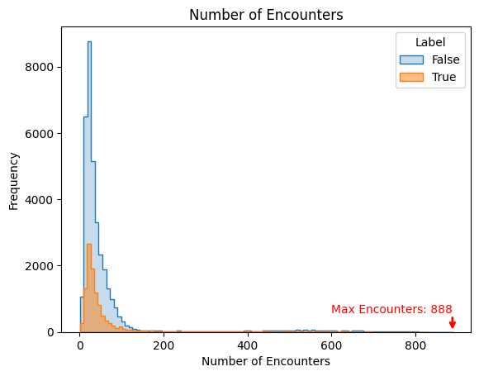
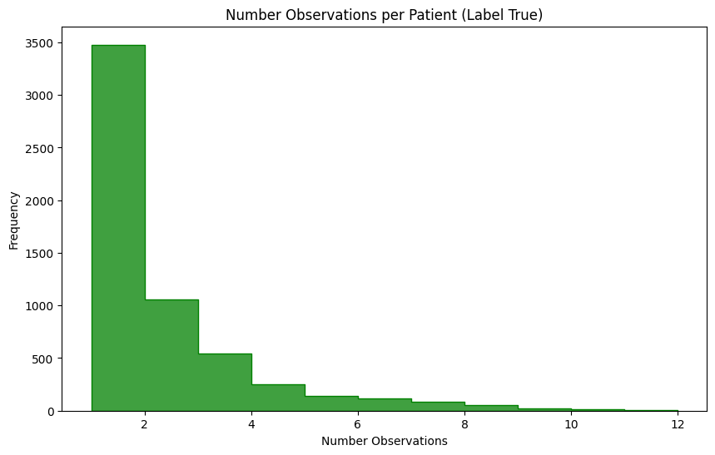
Project Setup - Models
Traditional Machine Learning
Logistic Regression
Random Forest
Deep Learning Models
Fully Connected Feed Forward
Attention Model
70/15/15 split
Oversampling
5756 -> 10983
Undersampled ‘Other class’
BioLORD-2023
Notes:
Here are the models I used to test
My traditional machine learning models include logistic regression and random forest
My deep learning models include a FC feed forward and a model using attention weights
I split my data into 70/15/15 split
The oversampling I discussed turned the number of ‘chest x-ray’ patients/observations from 5700 to 11000
I also undersampled the ‘Other’ class in the training dataset to match that of the ‘chest x-ray’ class count
And again, I use BioLORD-2023 – which is on huggingface
Here is a histogram showing the number of encounters per patient – it’s a pretty large dataset (this is the number of encounters, not the number of snomed codes associated with each patient)
And here is a histogram showing – in the oversampled data - the number of observations per patient, meaning many had just 1 chest xray, but lots had 3 or 4 or more.

Slide 8
Results
Averaged list of embeddings as input feats (count=768)
Optuna for hyperparameter tuning
10 studies done
Best params:
C: 8.666467071521883
solver: 'newton-cg'
Final Testing F1 Score: 88%
Confusion matrix
Traditional Machine Learning
Logistic Regression
Random Forest
Deep Learning Models
Fully Connected Feed Forward
Attention Model
 | 0 | 1
0 | 7335 | 278
1 | 344 | 1994
Notes:
So, how well did the models do?
Here is some information about the model, I averaged the list of input embeddings so that there was a standard input size the model can expect
I used optuna for hyperparameter tuning, I did 10 studies, these were the best parameters
The final F1 score was 88% which is pretty good. And shown is the CM

Slide 9
Results
Averaged list of embeddings as input feats (count=768)
Optuna for hyperparameter tuning
10 studies done
Best parameters:
n_estimators: 133
max_depth: 40,
min_samples_split: 4,
min_samples_leaf: 2,
max_features: 'sqrt'}
Final Testing F1 Score: 87%
Confusion Matrix:
Traditional Machine Learning
Logistic Regression
Random Forest
Deep Learning Models
Fully Connected Feed Forward
Attention Model
 | 0 | 1
0 | 7196 | 397
1 | 249 | 2109
Notes:
The Random Forest classifier was implemented very similarly
Averaged the list of embeddings as input
10 studies done with optuna, here are the best parameters, had a final testing F1 of 87%
And shown is the confusion matrix

Slide 10
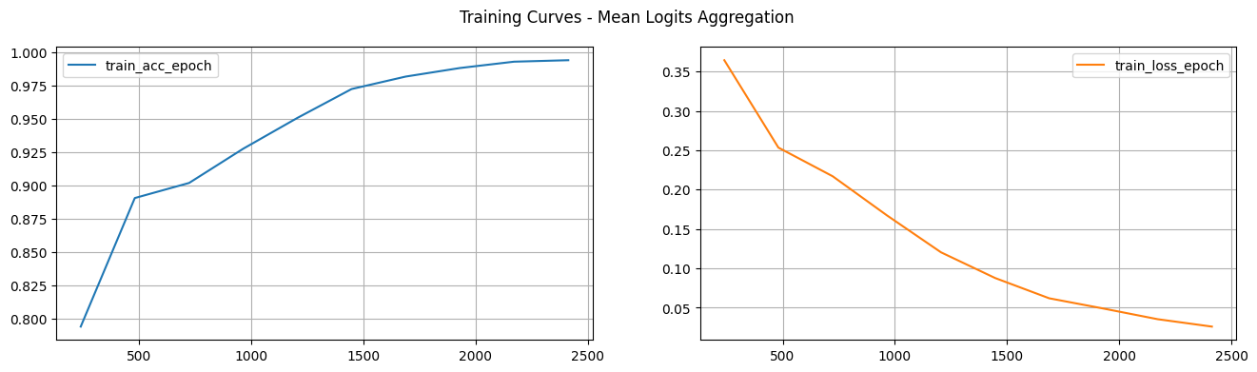
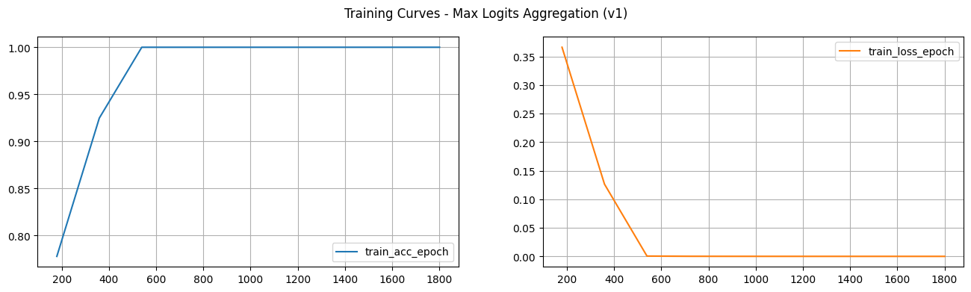
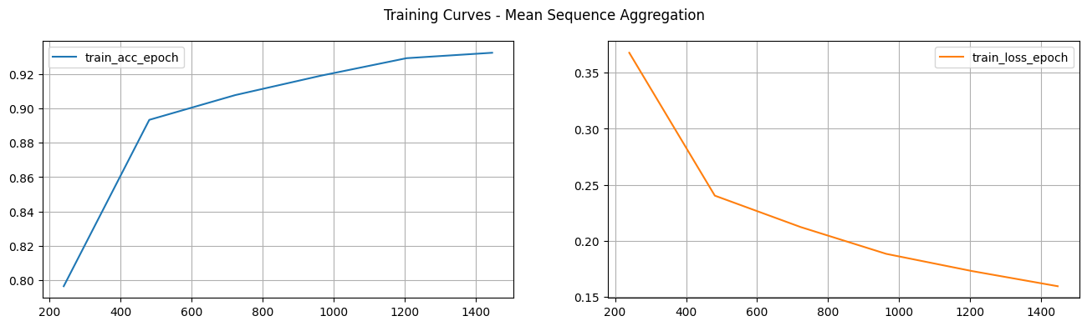
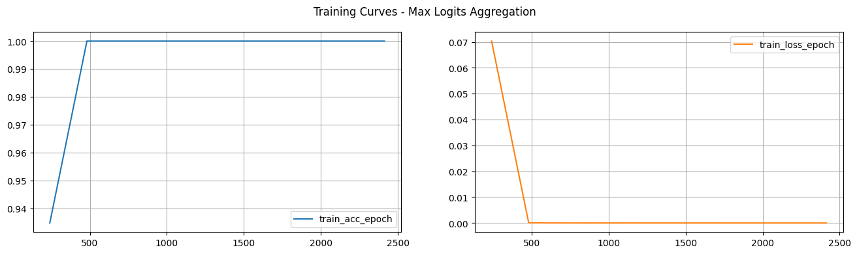
Results
3 aggregation methods tested
Logits mean agg
Logits max agg
Sequence mean agg
3 FC layers (128, 128 1)
BCEWithLogitsLoss
ReLU activation
Adam Optimizer, lr=0.001
BS=30
Final Testing F1 Score:
Mean Seq agg: 0.862
Mean Logits agg: 0.988
Max Logits agg: 1.0
Traditional Machine Learning
Logistic Regression
Random Forest
Deep Learning Models
Fully Connected Feed Forward
Attention Model
Notes:
For the fully connected feed forward, here are the details. There were three different aggregation techniques I tested:
I averaged the embeddings (like logistic regression and random forest)
I averaged the logits generated
And I took the max logits generated
The architecture consisted of 3 fully connected layers with sizes 128, 128 and 1
I used BCEWithLogitsLoss as my loss function
ReLU as my activation
Adam optimizer with a lr of 0.001
Batch size of 30
My final testing f1 scores for the different methods are:
86% for the mean sequences/embeddings
98% for the mean logits
And 100% for the max logits aggregation method
Here are the training accuracy and loss curves for each
Now, I thought maybe there was some bias in the model or some way the data was pre-processed that resulted in this, and that very well may be the case
But I did test the model with no oversampling – meaning each patient had only one set of features in the whole dataset (instead of possibly multiple as demonstrated with the oversampling performed)
But that also had very similar training curve and had a final testing f1 of 1.0

Slide 11

Results
MultiHeadAttention with 2 FC layers
6 attention heads
FC layers: 128, 1
BCEWithLogitsLoss
ReLU activation
Adam Optimizer, lr=0.001
BS=30
Final Testing F1 Score: 1.0
Traditional Machine Learning
Logistic Regression
Random Forest
Deep Learning Models
Fully Connected Feed Forward
Attention Model
Notes:
For the attention
The architecture consisted of an attention layer with 6 attention heads with 2 fully connected layers with sizes 128 and 1
I used BCEWithLogitsLoss as my loss function
ReLU as my activation for the FC layers
Adam optimizer with a lr of 0.001
Batch size of 30
My final testing f1 scores was 1.0 as well
And here’s the training curve

Slide 12
Testing F1 Scores
Notes:
To reiterate, there’s a side by side comparison of the testing f1 scores for each model.

Slide 13
Areas of Improvement
For ML models, test some other aggregation techniques
More studies for better hyperparameters
Ensure no bias in the pre-processing step
Test on actual prior-auth data
Test other models (VAE)
Notes:
That leads me to areas of improvement and future work
For the ML models, I would like to test other aggregation techniques – were they held back because of that?
I also obviously need to make sure there is no bias in the pre-processing step. I went through it a couple of times, but nothing stood out to me, so if anything stood out to you, please let me know
I also need to test on actual prior-auth data – and maybe do some unsupervised learning, like clustering / anomaly detection

Slide 14
Questions?

Slide 15
Sources
https://synthea.mitre.org/
https://huggingface.co/FremyCompany/BioLORD-2023
https://www.analytixhealthcaresolutions.com/2019/12/17/the-importance-of-prior-authorization-and-how-to-improve-its-process/
https://www.cigna.com/knowledge-center/what-is-prior-authorization

